Slide 1
Parallel Programing in the .NET Framework
CENG 471 – Parallel Programing
Atakan K. ÖZGÜN
200411040

Slide 2
Agenda
Parallelization in .NET Framework
Task Parallel Library
Parallel LINQ

Slide 3
Parallelization in .NET Framework
Utilizing multi core machines’ power (shared memory programming)
Single piece of work into multiple concurrent units
Partitioning options: Static and Parallel
Problems like scalability, load – imbalance and thread overhead

Slide 4
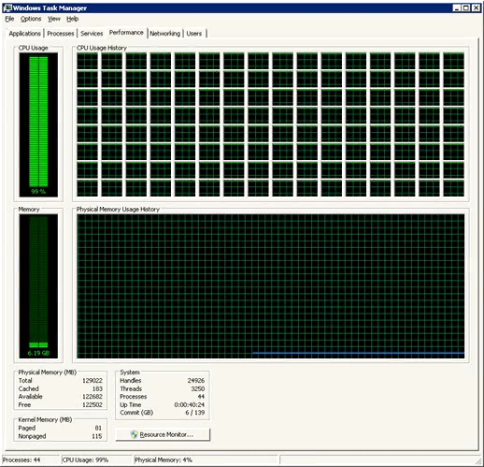

Slide 5
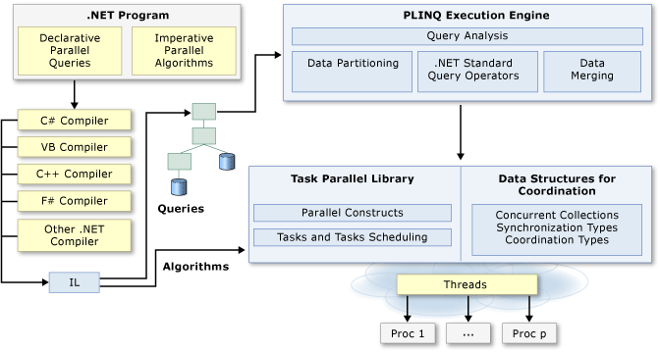
Parallelization in .NET Framework

Slide 6
.NET Thread Pool
Runtime
Scheduler with Thread Queue
Fire and Forget
Some short – comings:
Continuing
Composing
Monitoring data flow
Performing work cancellation
Work waiting

Slide 7
Task Parallel Library (TPL)
Introduced in .NET Framework 4.0
A public API to System.Threading and System.Threading.Tasks
Simplifies process of concurrency
Scheduling threads
Cancellation support
State Management

Slide 8
Task Parallel Library (TPL)
Higher level than threads
Gives you much more power and control over parallelization
Task Parallelism
Data Parallelism

Slide 9
Task Parallelism
Controlled over Task class
In a task’s lifetime
Handles infrastructure details
Provides methods and properties

Slide 10
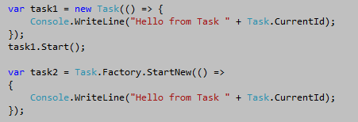
Task Parallelism
A task can be created via
Constructor
Factory

Slide 11
Task Class
A task can be
Waited
Continued with
Attached
Cancelled

Slide 12
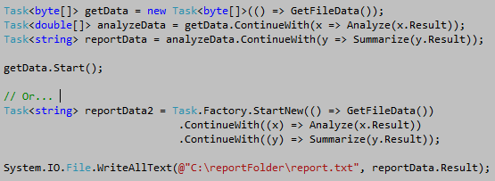
Creating Task Continuations

Slide 13
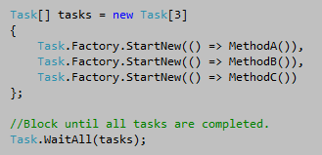
Waiting on Tasks
Task.WaitAll(Task[]) and Task.WaitAny(Task[])
Depandance of previous task
Exception handling

Slide 14
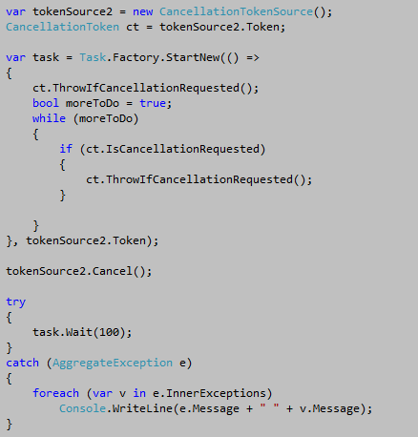
Cancellation

Slide 15
Data Parallelism
Same operation performed concurrently
A collectible type or an array
Source is partitioned
System.Threading.Tasks.Parallel class
For
Foreach

Slide 16
Parallel.For
It has several overloads.
General definition:
public static ParallelLoopResult For
( int fromInclusive,
int toExclusive,
Action<int> body )

Slide 17
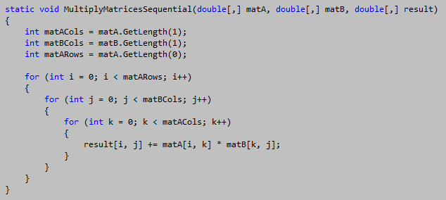
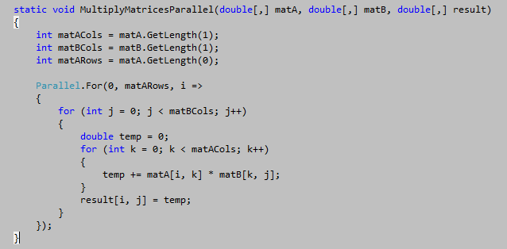
Parallel.For
Sequential For
Parallel For

Slide 18
Parallel.Foreach
It has several overloads.
General definition:
public static ParallelLoopResult ForEach<TSource>
( IEnumerable<TSource> source, Action<TSource> body )

Slide 19
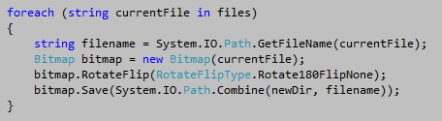

Parallel.Foreach
Sequential Foreach
Parallel Foreach

Slide 20

PLINQ
Nothing different than LINQ syntax
Except:
.AsParallel() -> Makes the rest of query parallel
.AsOrdered() -> Makes the rest of query ordered
.AsUnordered() -> Makes the rest of query unordered
WithDegreeOfParallelism<TSource> -> Sets max number of tasks run concurrently.

Slide 21
Calculating PI
100 M iterations

Slide 22
Conclusion
Disadvantages
Complexity
Advantages
Power of PLINQ
Thread safe

Slide 23
Parallel Programing in the .NET Framework
Thank you for listening.
Questions
?

