Slide 1
PGAC: A Parallel Genetic Algorithm for Data Clustering
Maşide AKGEYİK

Slide 2
SGAC: A Serial Genetic Algorithm for Clustering
SGAC NP-Hard a problem.
NP-Hard: NP(non-deterministic polinomial)
at least as hard as the hardest problems in NP.
Because of that, the aim is finding the parallel version of serial algorithm.

Slide 3
SGAC: A Serial Genetic Algorithm for Clustering
It takes K and X for input.
K: the number of phrase
X: cluster of data elements
It turns K times for output
Each chromosome represent by a whole number between {1,…,K}

Slide 4
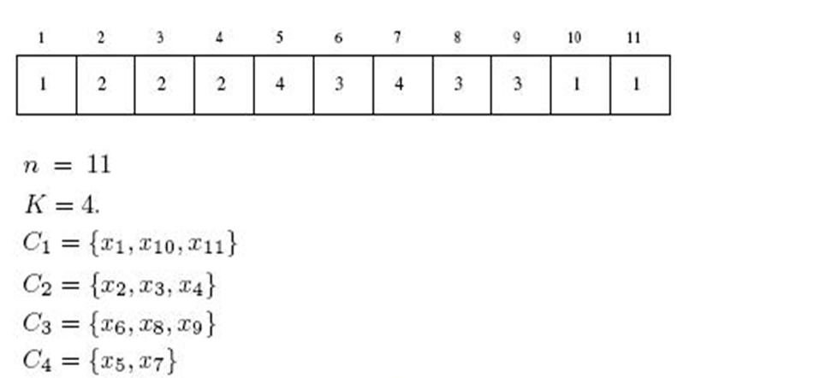

Example of Chromosome
Chromosome’s genes

Slide 5
SGAC: A Serial Genetic Algorithm for Clustering
“single point” cross-over model is using in this algorithm.
Single point: each time cross-over is appling to a single point
This model converts population numbers N to R when applying,
Every time parents are protected.
Mutation gene changes a gene between {1,…,K} randomly .

Slide 6
SGAC: A Serial Genetic Algorithm for Clustering
Selection time: “binary tournament selection”
Binary tournament selection: two gene randomly selecting
Stop criteria: maximum iteration number

Slide 7
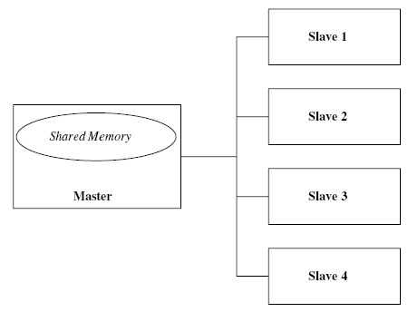
PGAC: Parallel Genetic Algorithm for Data Clustering
Uses the “island” model.
Uses the Master/ Slave distributed architecture.
It processor by 1 Master and 4 Slave, Master and Slave connected with high speed intranet.

Slide 8
Island Model
The chromosome divides sub-populations and these are called “deme”
Demes are different to each other, its don’t have intersections.
Each party runs in different deme.
Some parties migrate between demes.
There is some parameters to provide migration.
Migration rate(mr)
Migration Scheme
Migration Interval(mi)

Slide 9
PGAC
Each deme tall as N/D
N: Total population
D: The number of total deme
Each deme does “Nite” time iteration to evolve.
Nite: Total iteration number
Each deme is , sends the migration list and it is formed by mr cromosome whis is as much as mi iteration number.

Slide 10
PGAC
Migration scheme is the best chromosome for in the list of until iteration and randomly it provides chromosome as much as number of mr-1.
Finally, the best result for each deme is choosing from the best result of calculation and this is regarding as solution.
Migration is come true synchronically.

Slide 11
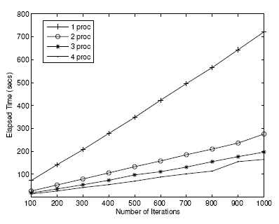
Result of Test

Slide 12
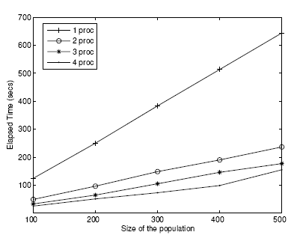
Result of Test

Slide 13

Result of Test
The time is decreases while the processor increases. Because every time population’s sizes divided by Slave processor number.
The number of slave equal to D (number of deme)
The Speed-Up which is implemented by parallel algorithm is like below:

Slide 14
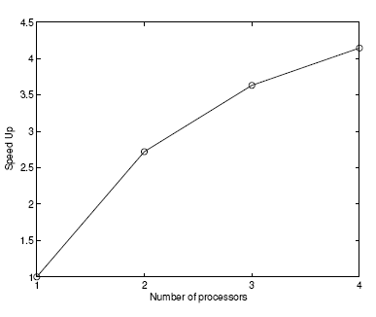
Result of Test

Slide 15

Result of Test
The figure of Overhead parallel algorithm processor which acquired from D:

Slide 16
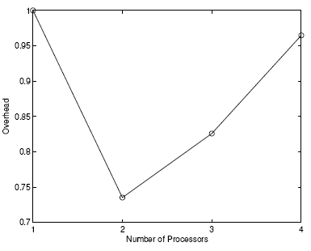
Result of Test

Slide 17
Result of Test
As you see in figure, Overhead process number decreased between 1-2 and after a while it increased again. The reason of this is if slave number increases, calculation number decreases.
This is limitation of Master/Slave architecture.

Slide 18
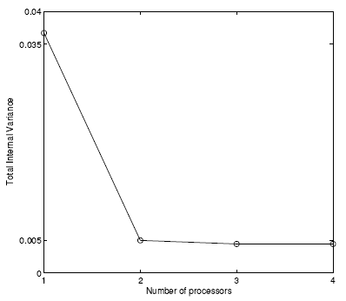
Result of Test

Slide 19
Conclution
Finally, the best result for each deme is choosing from the best result of calculation and this is regarding as solution.
Migration is come true synchronically.
The application achieved with low cost of Master/Slave’s distributed architecture.
Speed Up, Overhead and classification is given good result in the way of right solution.

